Slide 1
BUSQOM 1080 Simple Linear Regression
Fall 2020
Lecture 9
Professor: Michael Hamilton

Slide 2
Lecture Summary
Overview of hypothesis tests so far.
How to learn relations between numeric data: Simple Linear Regression
Motivations. [5 Mins]
Examples of Simple Linear Regression [5 Mins]
Correlation and the cor.test() [5-10 Mins]
Simple Linear Regression in R.
Plotting.
Simple Linear Regression Examples.

Slide 3
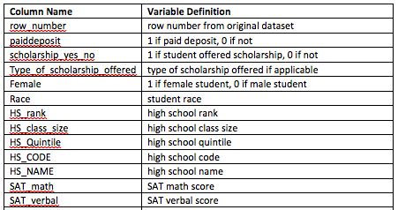
Data for first half of lecture
Save cba_admissions_1999.txt in your working directory
cba =read.table(“cba_admissions_1999.txt”, sep = "\t", header = T, quote = “”, allowEscapes = T)
880 obs of applicants to cba
Contains demographic info
…

Slide 4
Overview of Hypothesis Testing so Far
Descriptive statistics & graphs
Statistical inference (statistical tests)
Test | Number of Variables | Type of Variable
 |  | Variable 1 | Variable 2
Chi-square test for counts | 1 | Categorical | -
 | 2 | Categorical | Categorical
Test for proportions | 1 | Categorical (2 levels) | Constant
 | 2 | Categorical (2 levels) | Categorical (2 levels)
t-test for means | 1 | Numeric | Constant
 | 2 | Numeric | Categorical (2 levels)

Slide 5
Review: ANOVA in R
Type of Data | Test Application | Test | R function(s) | Notes
Numeric Response | Compare Means for more than 2 groups (levels of 1 factor) | One-way ANOVA | result = lm(numeric variable ~ grouping variable, data = name of data frame) anova(result) OR result = aov(numeric variable ~ grouping variable, data = name of data frame) summary(result) | Do not use if extreme outliers, skewed data, or unequal variance across groups
 | Compare Means for more than 2 groups (levels of 2 factors) | Two-way ANOVA (with interaction) | result = lm(numeric variable ~ grouping variable 1 * grouping variable 2, data = name of data frame) anova(result) | May also use aov() and summary() functions Using * adds interaction
 |  | Two-way ANOVA (without interaction) | result = aov(numeric variable ~ grouping variable 1 + grouping variable 2, data = name of data frame) summary(result) | May also use lm() and anova() functions Using + excludes interaction

Slide 6
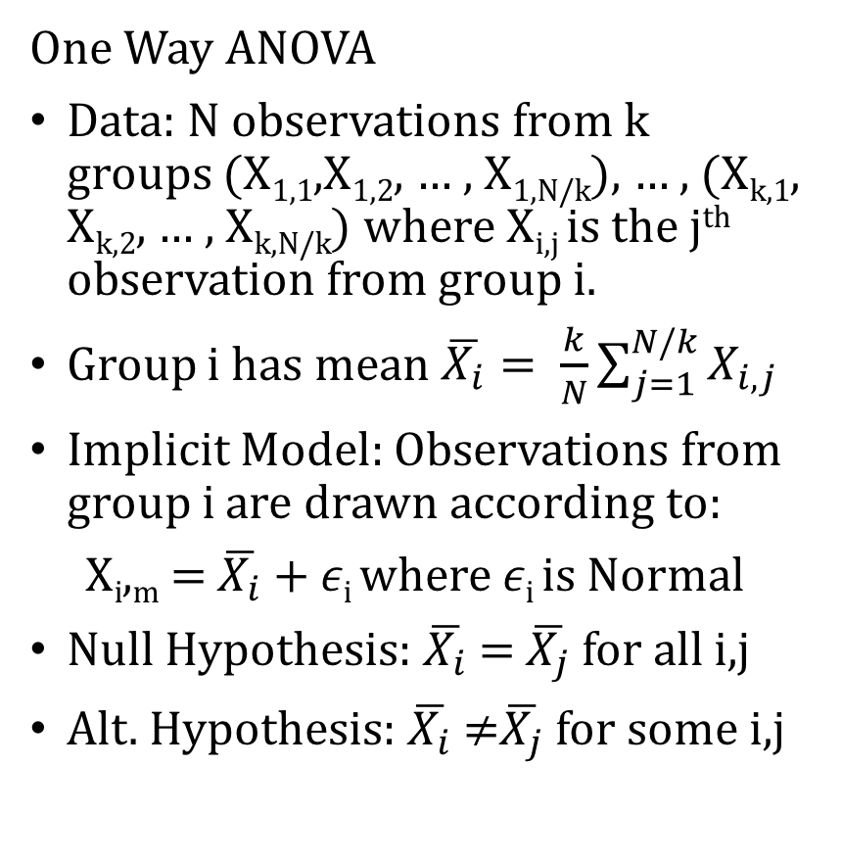
Review: One Way ANOVA
One Way ANOVA
Data: N observations from k groups (X_{1,1},X_{1,2}, … , X_{1,N/k}), … , (X_{k,1}, X_{k,2}, … , X_{k,N/k}) where X_{i,j} is the j^{th} observation from group i.
Group i has mean $\overline{X_{i}}= \frac{k}{N}\sum_{j=1}^{N/k}{X_{i,j}}$
Implicit Model: Observations from group i are drawn according to:
X_{i},_{m} = $\overline{X_{i}}$ + 𝜖_{i} where 𝜖_{i} is Normal
Null Hypothesis: $\overline{X_{i}}$ = $\overline{X_{j}}$for all i,j
Alt. Hypothesis: $\overline{X_{i}}$ ≠$\overline{X_{j}}$for some i,j
Example: Do SAT math scores differ between PA, NJ, and NY?
> cba = read.table("cba_admissions_1999.txt", sep = "\t", header = T, quote = "", allowEscapes = T)
> cba3 = cba[cba$state %in% c("PA", "NJ", "NY"),]
> res = lm(cba3$SAT_math ~ cba3$state)
> anova(res)
Analysis of Variance Table
Response: cba3$SAT_math
Df Sum Sq Mean Sq F value Pr(>F)
cba3$state 2 71770 35885 8.0478 0.0003483 ***
Residuals 747 3330851 4459

Slide 7
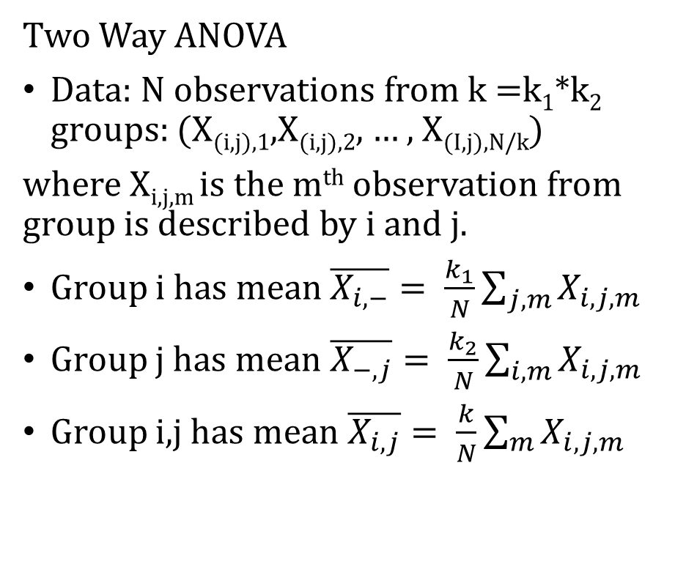

Review: Two Way ANOVA
Correction for factor 1 = i
Two Way ANOVA
Data: N observations from k =k₁*k₂ groups: (X_{(i,j),1},X_{(i,j),2}, … , X_{(I,j),N/k})
where X_{i,j,m} is the m^{th} observation from group is described by i and j.
Group i has mean $\overline{X_{i, −}}= \frac{k_{1}}{N}\sum_{j,m}{X_{i,j,m}}$
Group j has mean $\overline{X_{−, j}}= \frac{k_{2}}{N}\sum_{i,m}{X_{i,j,m}}$
Group i,j has mean $\overline{X_{i, j}}= \frac{k}{N}\sum_{m}{X_{i,j,m}}$
Implicit Model: Observations from group i,j are drawn according to:
X_{i,j,m} $=\overline{X}$+ ($\overline{X_{i, −}}$ - $\overline{X}$) + ($\overline{X_{j,−}}$- $\overline{X}$ )
+ ($\overline{X_{i, j}}$- $\overline{X_{i, −}}$- $\overline{X_{j,−}}$+ $\overline{X}$) +𝜖_{i,j}
where $\overline{X}$ is the grand mean, 𝜖_{i,j} is normal.
Correction for factor 2 = j
Interaction term: Correction for i and j.

Slide 8
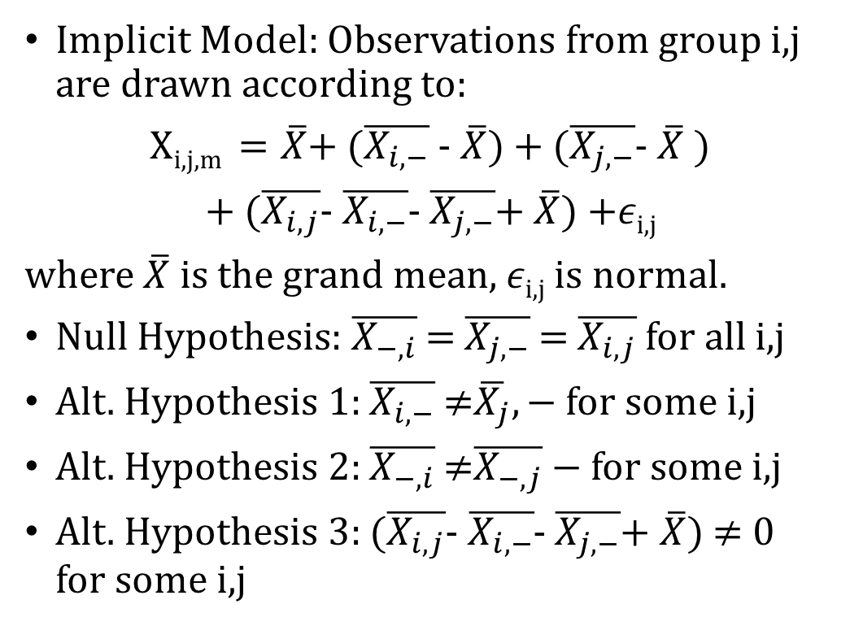
Review: Two Way ANOVA
Two Way ANOVA
Data: N observations from k =k₁*k₂ groups: (X_{(i,j),1},X_{(i,j),2}, … , X_{(I,j),N/k})
where X_{i,j,m} is the m^{th} observation from group is described by i and j.
Group i has mean $\overline{X_{i, −}}= \frac{k_{1}}{N}\sum_{j,m}{X_{i,j,m}}$
Group j has mean $\overline{X_{−, j}}= \frac{k_{2}}{N}\sum_{i,m}{X_{i,j,m}}$
Group i,j has mean $\overline{X_{i, j}}= \frac{k}{N}\sum_{m}{X_{i,j,m}}$
Implicit Model: Observations from group i,j are drawn according to:
$\text{X}\text{i}\text{,}\text{j}\text{,}\text{m} =\overline{X}$+ ($\overline{X_{i, −}}$ - $\overline{X}$) + ($\overline{X_{j,−}}$- $\overline{X}$ )
+ ($\overline{X_{i, j}}$- $\overline{X_{i, −}}$- $\overline{X_{j,−}}$+ $\overline{X}$) +𝜖_{i,j}
where $\overline{X}$ is the grand mean, 𝜖_{i,j} is normal.
Null Hypothesis: $\overline{X_{−,i}}$ = $\overline{X_{j,−}}$= $\overline{X_{i,j}}$for all i,j
Alt. Hypothesis 1: $\overline{X_{i,−}}$ ≠$\overline{X_{j}},−$for some i,j
Alt. Hypothesis 2: $\overline{X_{−,i}}$ ≠$\overline{X_{−,j}}−$for some i,j
Alt. Hypothesis 3: ($\overline{X_{i, j}}$- $\overline{X_{i, −}}$- $\overline{X_{j,−}}$+ $\overline{X}$) ≠ 0 for some i,j
Test for Interaction Effect, Omitted in Additive Model

Slide 9
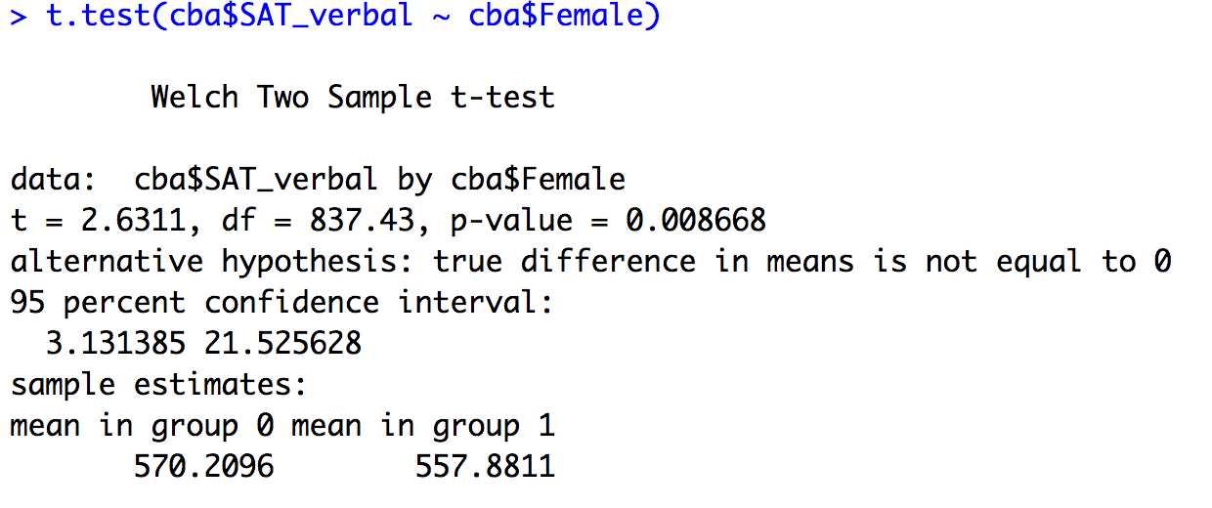
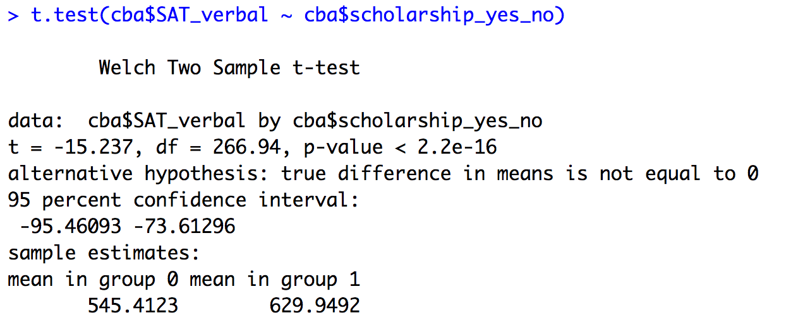
Review: One Way ANOVA
Example: Does gender have a significant effect on mean sat verbal score in the cba dataset? Does scholarship have a significant effect on mean sat verbal score? Does the interaction of gender and scholarship have a significant effect on sat verbal score? Be sure to remove NA from cba.
Run a t.test() for both factors.
Run anova with interaction for the two factors.
Run anova without interaction for the two factors.

Slide 10
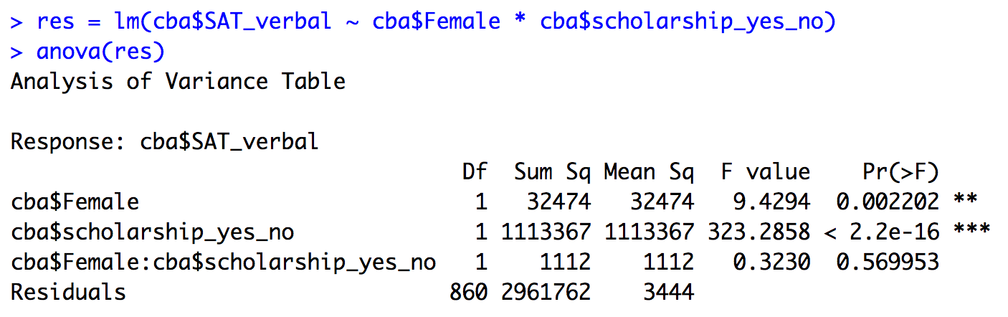
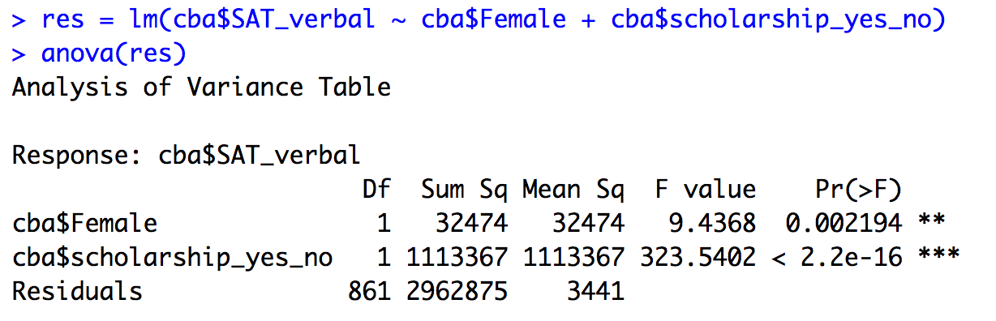
Review: One Way ANOVA
Example: Does gender have a significant effect on mean sat verbal score in the cba dataset? Does scholarship have a significant effect on mean sat verbal score? Does the interaction of gender and scholarship have a significant effect on sat verbal score? Be sure to remove NA from cba.
Run a t.test() for both factors.
Run anova with interaction for the two factors.
Run anova without interaction for the two factors.

Slide 11
Review: Steps for One-Way ANOVA
Fit ANOVA model:
If result not statistically significant, you’re done (no differences exist)
If result statistically significant (at least one difference among group means), follow-up with multiple comparisons:
TukeyHSD(aov result) (To be covered in homework 4!)
OR
pairwise.t.test(numeric column, categorical column, p.adjust.method = "bonferroni") (To be covered in homework 4!)
Check assumptions using plot.

Slide 12
Review: Steps for Two-Way ANOVA
Fit ANOVA model with interaction:
If interaction not statistically significant, fit ANOVA model without interaction (additive model)
Test & interpret each “main effect” separately
If any factors statistically significant (at least one group mean differs across the factor levels), follow-up with multiple comparisons
If interaction statistically significant, follow-up with interaction plots and multiple comparisons:
interaction.plot(categorical column 1, categorical column 2, numeric column)
TukeyHSD(aov result) (Homework 4!)
Do not test/interpret main effects
Check assumptions.

Slide 13
Overview of Hypothesis Testing so Far
Test | Number of Variables | Type of Variable
 |  | Variable 1 | Variable 2
Chi-square test for counts | 1 | Categorical
 | 2 | Categorical | Categorical
Test for proportions | 1 | Categorical (2 levels)
 | 2 | Categorical (2 levels) | Categorical (2 levels)
t-test for means | 2 | Numeric
 | 2 | Numeric | Categorical (2 levels)
ANOVA | 2 or more | Numeric | Categorical
Descriptive statistics & graphs
Statistical inference (statistical tests)

Slide 14
Motivation for Simple Linear Regression
What if we want to measure and or fit a relationship between a numeric explanatory variable and a numeric response variable?
Examples:
Among a population, how does Weight relate to Age?
Within a harvest, how does apple shine relate to apple weight?
Within a class, how do SAT_math scores relate to SAT_verbal scores?
For a developed economy, how does median wage relate to GDP?
To understand these relationships we’ll use Simple Linear Regression, to fit a linear dependence between the explanatory variable and the response. We also learn when assuming such a relationship is valid.

Slide 15
Topic: Simple Linear Regression
Instructor’s note: I pathologically cannot stop saying feature
Terminology:
X = explanatory variable (independent variable, feature variable)
Y = response variable (dependent variable)
“Regress X on Y” will mean to learn a model where Y depends on X
Goal:
Using data pairs {(x_{i}, y_{i})}, fit a linear relationship between Y and X i.e. a straight line that “best” explains the data (best will be defined later).
Specifically, use the data to estimate a slope and the intercept of a line
Notes:
Simple refers to the fact that there is a single (1) explanatory variable (feature)
Today we are only talking about linear (straight line) relationships
These are just points on a scatterplot!

Slide 16
Example: SAT_verbal vs SAT_math
Set-up: cba data includes two numeric columns: SAT_math which we will treat as independent (X) and SAT_verbal which we will treat as a response variable(Y).
Want to fit a linear relationship: Y = β₀ + β₁ X
Y is the variable corresponding to SAT_verbal
X is the variable corresponding to SAT_math
β₀ , β₁ are fitted constants
Plan: Draw a scatterplot showing each obs. in cba as a dot whose (X, Y) coordinates are their scores of those variables, then fit lines!

Slide 17
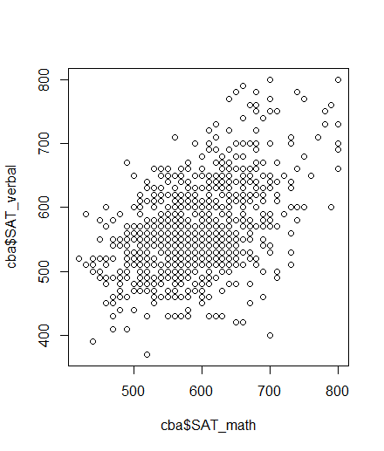
Scatter Plot of SAT_Math & SAT_Verbal
> plot(cba$SAT_math, cba$SAT_verbal)
Questions to ponder
There are many possible “fits”, which of these lines is the best?
How can we tell if there even is a relationship?
What would a scatterplot look like when there was no relationship?
What could a scatterplot look like if there’s a relationship but it’s not linear?

Slide 18
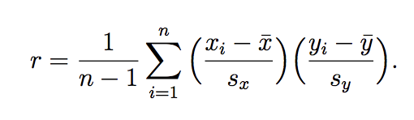
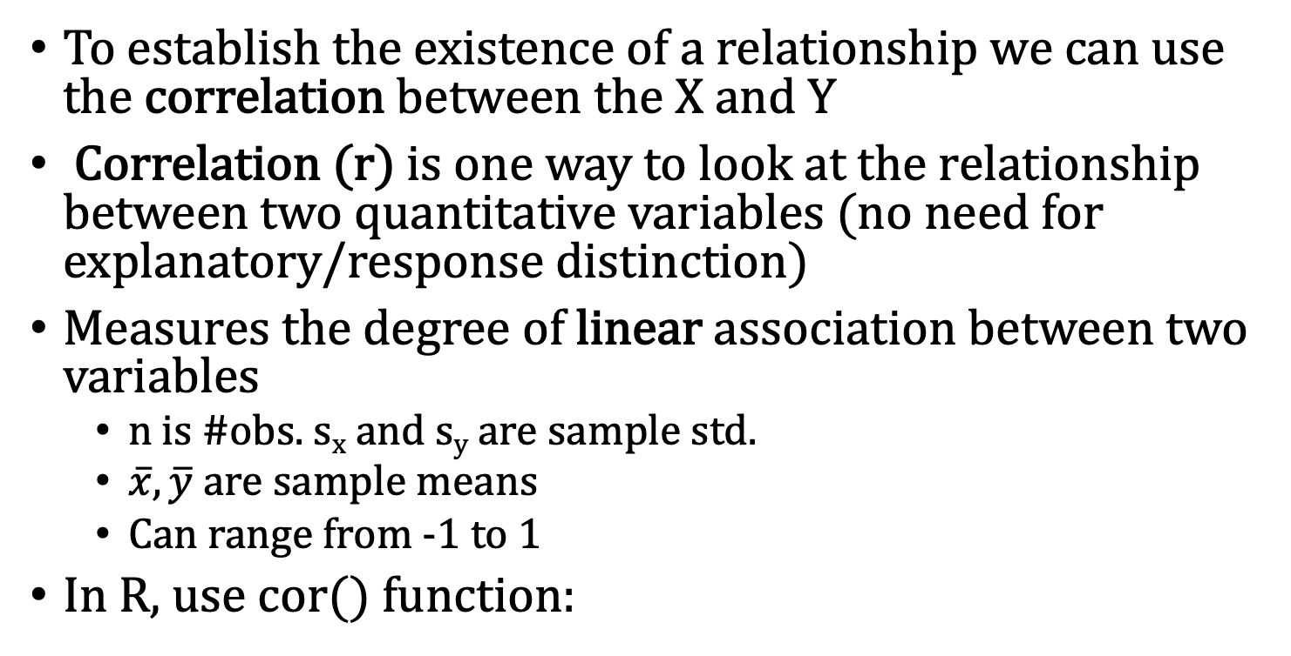
Checking for Lin. Relationship: Correlation
To establish the existence of a relationship we can use the correlation between the X and Y
Correlation (r) is one way to look at the relationship between two quantitative variables (no need for explanatory/response distinction)
Measures the degree of linear association between two variables
n is #obs. s_{x} and s_{y} are sample std.
$\overline{x}, \overline{y}$ are sample means
Can range from -1 to 1
In R, use cor() function:
cor(cba$SAT_math, cba$SAT_verbal) [1] 0.463591
Two numeric columns

Slide 19
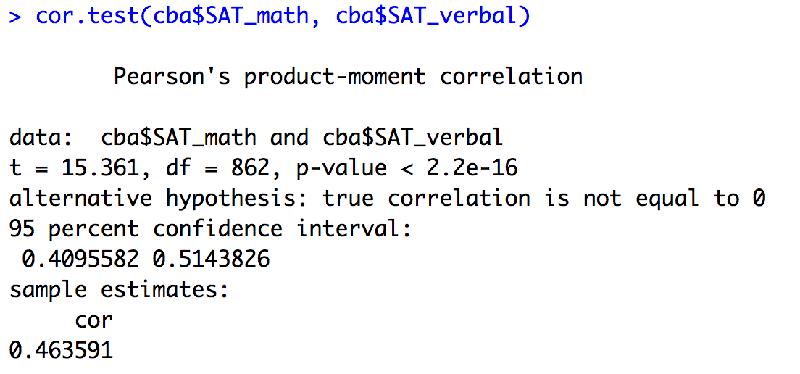
Hypothesis Test: cor.test() function
To see if there’s a relationship, we can test if correlation is statistically different from 0 using a correlation test. In R we do this with cor.test().
Two numeric columns
p-value
Here, we’re testing if the correlation is different from zero or not.
p-value < 0.01 → different from 0
Same sample correlation

Slide 20
Notes about Correlation
For a relationship between one X variable (the covariate, or predictor, or feature) and one Y variable (the response, or independent variable), correlation shows the magnitude and direction of the relationship.
Does not imply causation or lack there of. Easy to construction examples with no correlation but obvious nonlinear causation (see the notebook for such an example.
Cannot be used for prediction, it does not model the relationship.

Slide 21
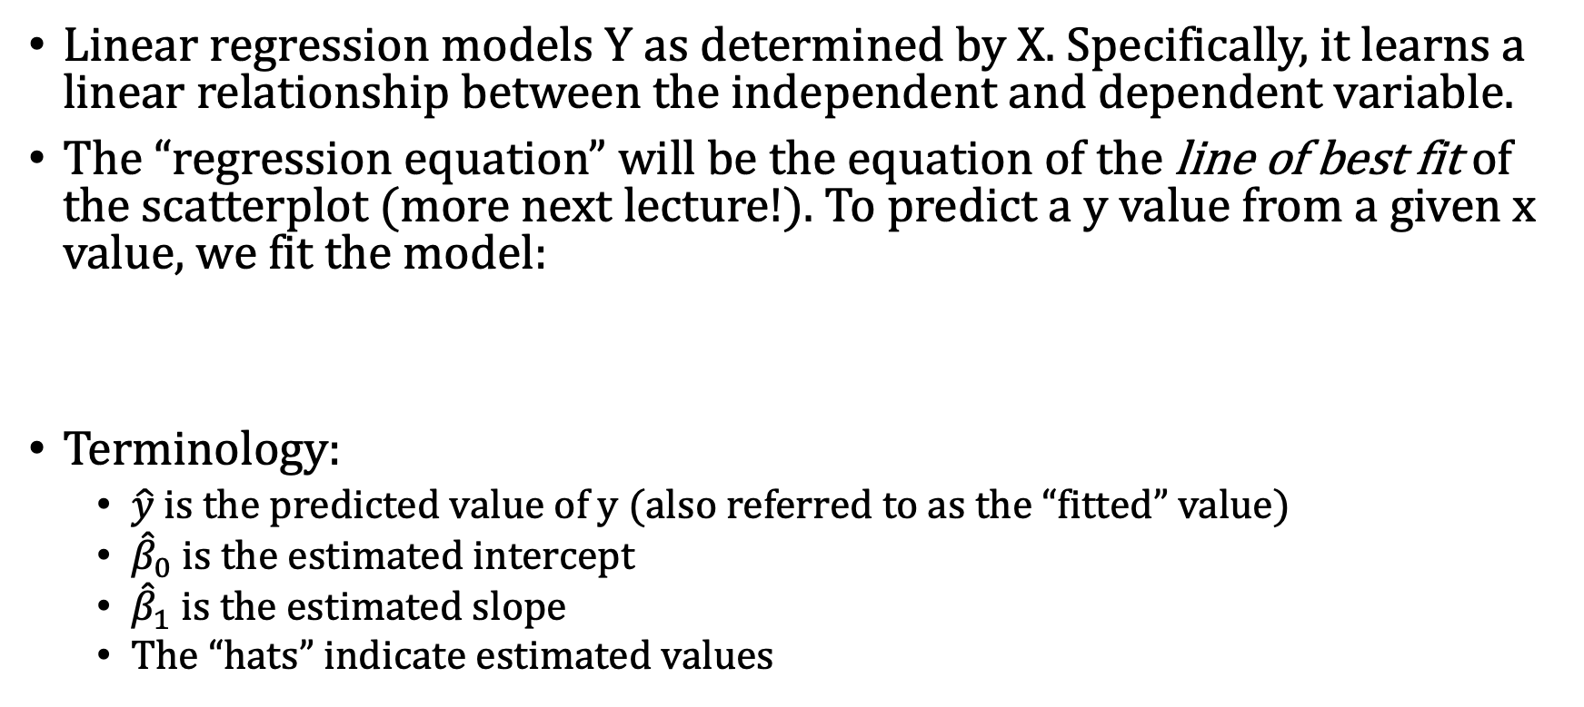
Topic: Simple Linear Regression
Linear regression models Y as determined by X. Specifically, it learns a linear relationship between the independent and dependent variable.
The “regression equation” will be the equation of the line of best fit of the scatterplot (more next lecture!). To predict a y value from a given x value, we fit the model:
Terminology:
$\hat{y}$ is the predicted value of y (also referred to as the “fitted” value)
${\hat{β}}_{0}$is the estimated intercept
${\hat{β}}_{1}$ is the estimated slope
The “hats” indicate estimated values

Slide 22
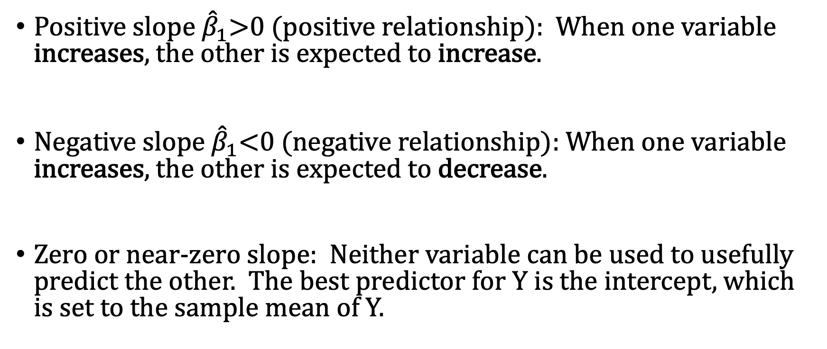
Interpretation of Regression Equation
Regression Model:
Positive slope ${\hat{β}}_{1}$>0 (positive relationship): When one variable increases, the other is expected to increase.
Negative slope ${\hat{β}}_{1}$<0 (negative relationship): When one variable increases, the other is expected to decrease.
Zero or near-zero slope: Neither variable can be used to usefully predict the other. The best predictor for Y is the intercept, which is set to the sample mean of Y.

Slide 23
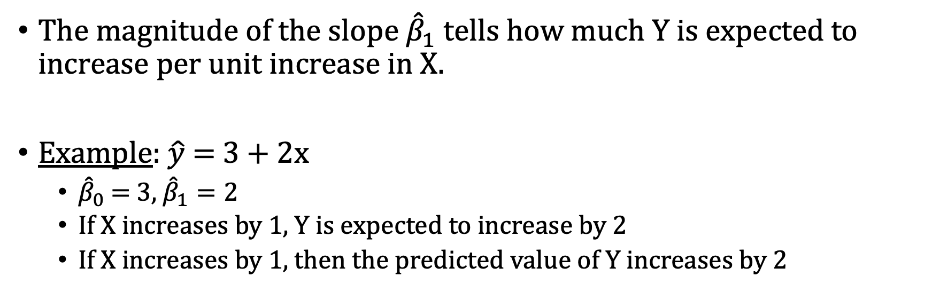
Interpretation of Regression Equation
The magnitude of the slope ${\hat{β}}_{1}$ tells how much Y is expected to increase per unit increase in X.
Example: $\hat{y}$ = 3 + 2x
${\hat{β}}_{0}$ = 3, ${\hat{β}}_{1}=2$
If X increases by 1, Y is expected to increase by 2
If X increases by 1, then the predicted value of Y increases by 2

Slide 24
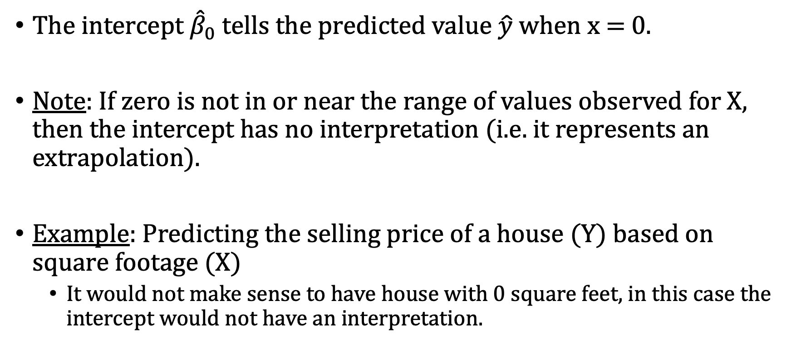
Interpreting the Intercept
The intercept ${\hat{β}}_{0}$ tells the predicted value $\hat{y}$ when x = 0.
Note: If zero is not in or near the range of values observed for X, then the intercept has no interpretation (i.e. it represents an extrapolation).
Example: Predicting the selling price of a house (Y) based on square footage (X)
It would not make sense to have house with 0 square feet, in this case the intercept would not have an interpretation.
Notes:
24

Slide 25
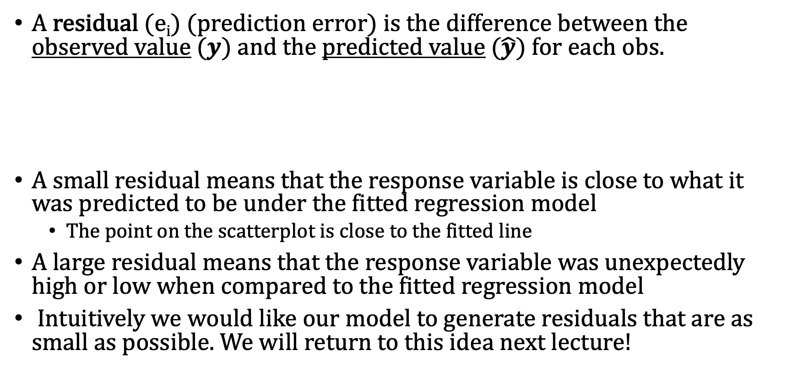
Residuals of Linear Model
A residual (e_{i}) (prediction error) is the difference between the observed value $(y)$ and the predicted value $(\hat{y})$ for each obs.
A small residual means that the response variable is close to what it was predicted to be under the fitted regression model
The point on the scatterplot is close to the fitted line
A large residual means that the response variable was unexpectedly high or low when compared to the fitted regression model
Intuitively we would like our model to generate residuals that are as small as possible. We will return to this idea next lecture!
Notes:
25

Slide 26
Simple Linear Regression in R
Determine numeric features in the data representing the response (Y) and explanatory (X) variables
Plot the data in a scatterplot to see if there is a linear relationship and/or run a cor.test() to determine if there is a linear relationship
Run the regression analysis in R using the lm() function (lm stands for linear model).
Let’s switch data sets
Load in the house.txt dataset:
> house = read.table("house.txt", sep = "\t", header = T)
Contains data on 590 homes sold between May 2014 and May 2015 in one zip code (98038) in King County

Slide 27
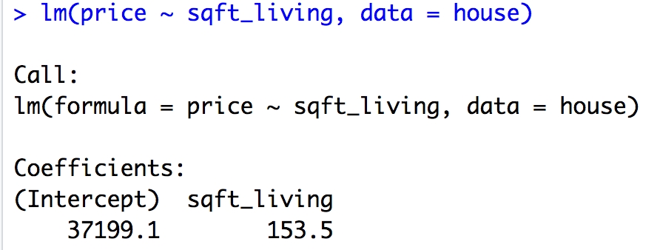
Simple Linear Regression in R
Example: Try and predict price from sq ft of living space.
Numeric response
Numeric explanatory variable
Identify data frame
This gives us an estimate of the regression line:
Sales = 37199.1 + 153.5 sqft_living
This is the straight line that best fits the data
Intercept
Slope

Slide 28
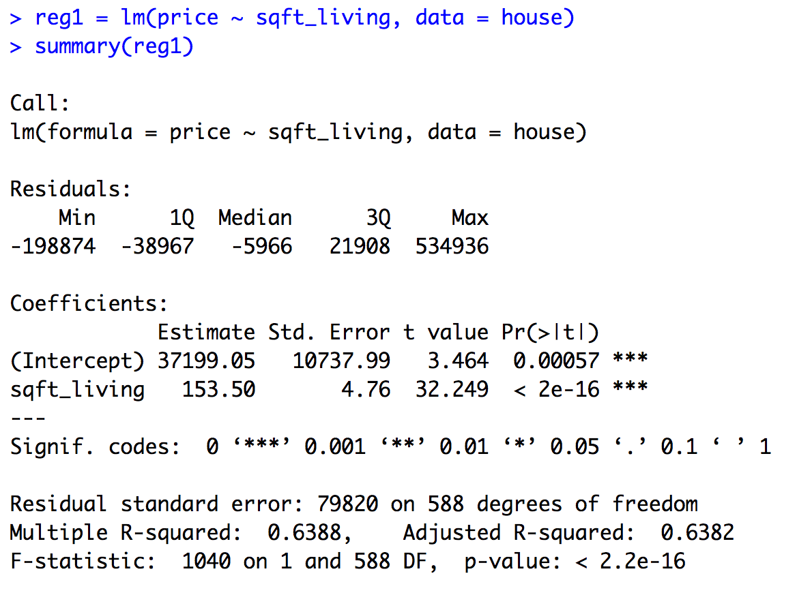
Simple Linear Regression in R
Save regression equation
Use summary function
Coefficients for regression equation
p-value (testing if slope = 0 or not)
R²

Slide 29
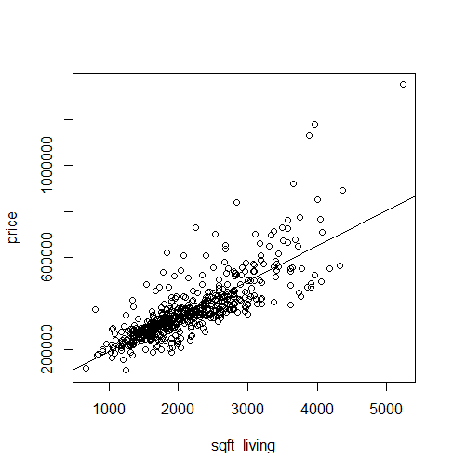
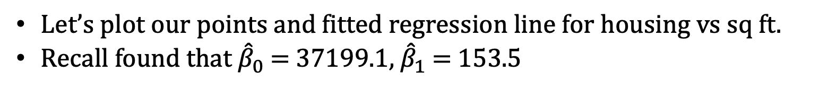
Plotting Simple Linear Regression in R
Let’s plot our points and fitted regression line for housing vs sq ft.
Recall found that ${\hat{β}}_{0}$ = 37199.1, ${\hat{β}}_{1}$ = 153.5
> plot(price ~ sqft_living, data = house)
> abline(37199.05, 153.50)
Fitted Intercept
Fitted Slope

Slide 30
Inference from Regression
Usually we want our regression equation to apply to data other than just the observations in the sample i.e. we want to predict on future on observations. To do this we need assumptions on how the data is made!
Imagine that in the population, the values of Y really are generated from the linear probabilistic model
where ε is an error term with mean 0 and variance σ²
We will call the above the Assumed Probabilistic Linear Model
For our linear regression inference we will always assume ε has a normal distribution. N(0, σ²)

Slide 31
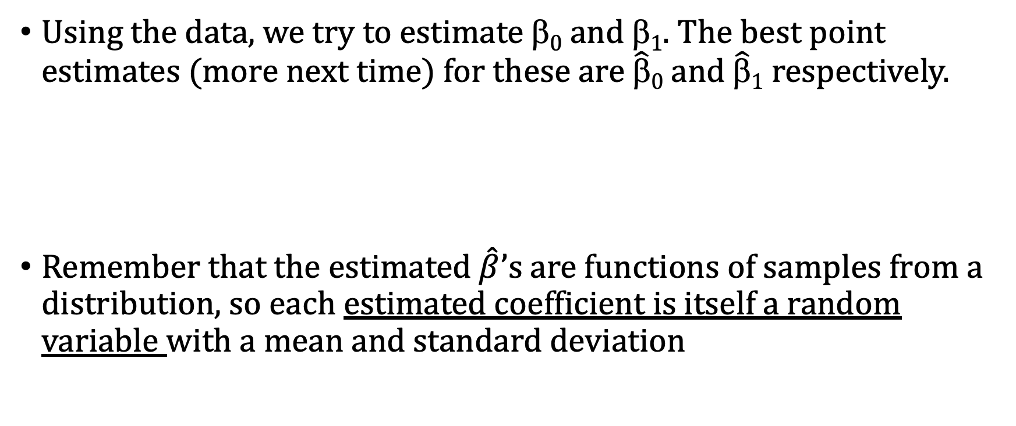
Inference vs Line of Best Fit
Assumed Prob. Linear Model:
Using the data, we try to estimate $0$and $1$. The best point estimates (more next time) for these are $\hat{β}0$and $\hat{β}1$respectively.
Remember that the estimated $\hat{β}$’s are functions of samples from a distribution, so each estimated coefficient is itself a random variable with a mean and standard deviation
Estimated Linear Model:

Slide 32
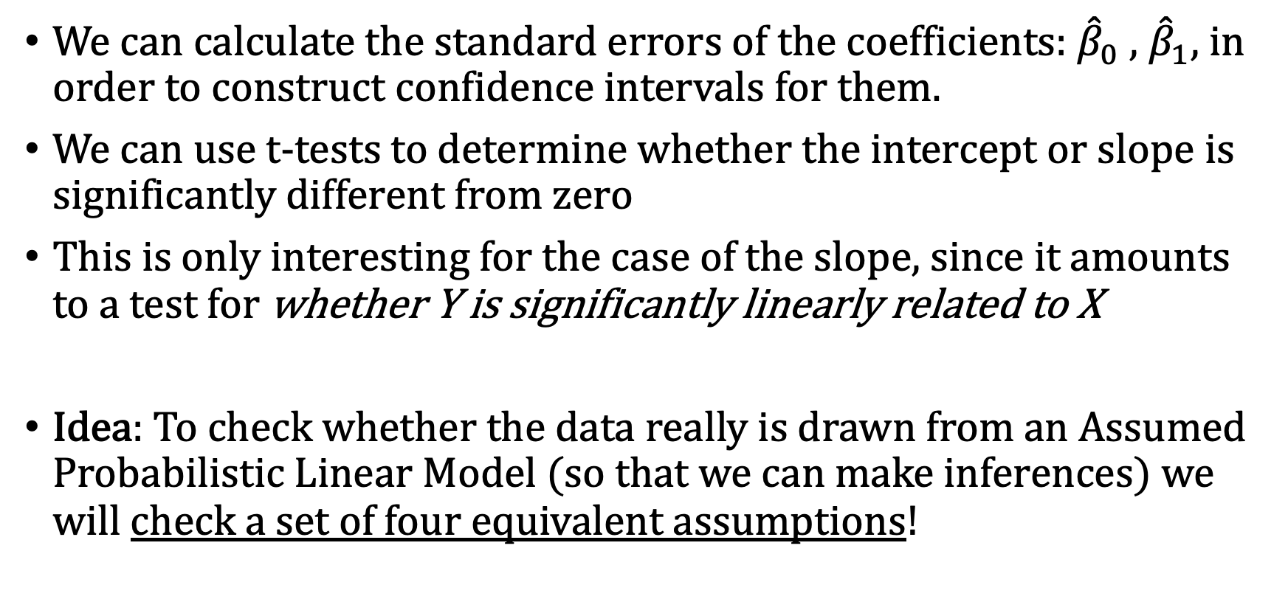
Sampling Distributions & Inference
We can calculate the standard errors of the coefficients: ${\hat{β}}_{0}$ , ${\hat{β}}_{1}$, in order to construct confidence intervals for them.
We can use t-tests to determine whether the intercept or slope is significantly different from zero
This is only interesting for the case of the slope, since it amounts to a test for whether Y is significantly linearly related to X
Idea: To check whether the data really is drawn from an Assumed Probabilistic Linear Model (so that we can make inferences) we will check a set of four equivalent assumptions!

Slide 33
Four testable model assumptions
Linearity: Linear association between the dependent variable and the independent variable
The mean values of response variables fall on a straight line as a function of the explanatory variable
Normality: Normality of the distribution of errors i.e. normality of the residuals (qqplot of residuals is diagonal)
Independence: Independence of the errors around the regression line between the actual and predicted values of the response variable

Slide 34
Four testable model assumptions
Constant variance: Equal variance of the distribution of the response variable for each level of the independent variable. (homoscedasticity)
The spread of the response around the straight line is same for all levels of explanatory variable
Errors have constant variance
Ways this can go wrong:
a) equal variance b) non-linear (curvilinear) c) increasing variance d) time trend

Slide 35
Checking the Assumptions in R
We have to check to see whether these assumptions are reasonable or not. Note these assumptions are equivalent to saying our assumed probabilistic model holds
Linearity → Use Residuals vs. Fitted plot
Independence → Use Durbin-Watson test (next lecture)
Normality → Use Normal Q-Q plot
Equal Variance → Use Residuals vs. Fitted plot
Another option: Use the gvlma() function in the gvlma package

Slide 36
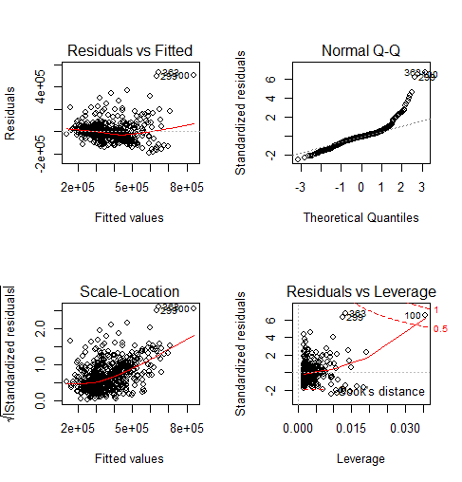
Assumptions of Simple Lin. Regression in R
Lets check the assumptions of our model
> reg1 = lm(price ~ sqft_living, data = house)
> par(mfrow = c(2,2))
> plot(reg1)

Slide 37
Back to SAT_math vs SAT_verbal (nb)
Example: Lets return to SAT_math vs SAT_verbal.
Fit a simple linear regression between SAT_verbal and SAT_math using lm().
Write out the regression equation.
Write out the 95% confidence interval for intercept and slope.
Plot the regression line against the scatter plot, be sure to appropriately label your plot!
Check the assumptions by plotting the residuals, comment on trends you see in the data.

Slide 38
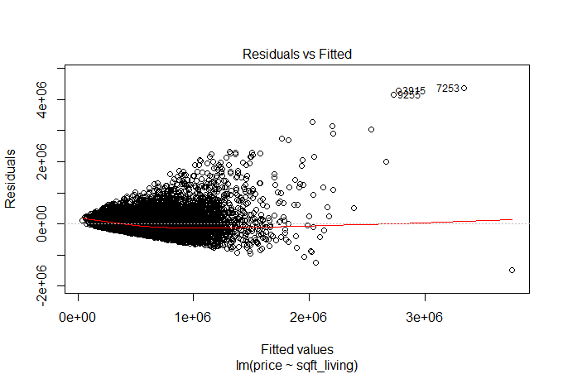
Fitted Values vs. Residuals
Looking for equal variance & linearity
Not looking for
Curvilinear
Non-constant variance
Outliers
Time trends

Slide 39
a) equal variance b) non-linear (curvilinear) c) increasing variance d) time trend

Slide 40
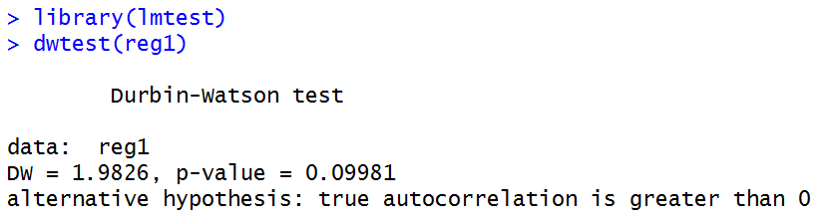
Checking for Independence
install.packages(“lmtest”)
Use dwtest(lm result)
Testing if residuals from regression model are correlated:
Large p-value → Residuals not correlated (GOOD)
Small p-value → Correlated residuals (BAD)

Slide 41
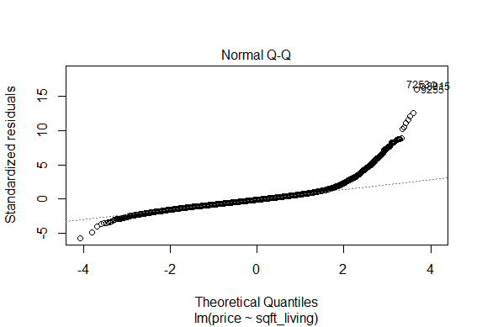
Normal Probability Plot
Looking for points to fall along dashed line (normal distribution)

Slide 42
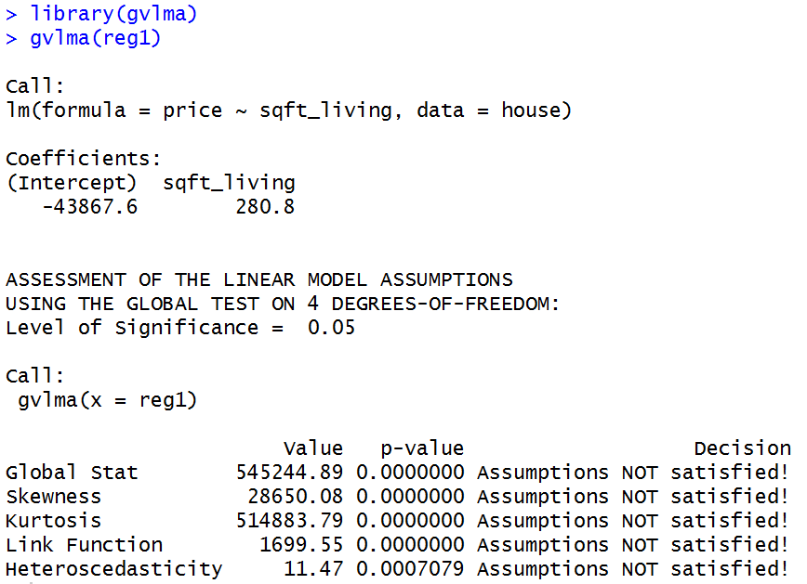
Another way to check assumptions: gvlma()
install.packages(“gvlma”)
Data clearly violates the regression assumptions

Slide 43
Note
Explanatory or Predictor variables don’t have to be normally distributed
The residuals should be normally distributed
The variability in Y that is left over after we accounted for X should follow a normal distribution

Slide 44
Coefficient of Determination
The coefficient of determination, R², is the proportion of variability in Y accounted for by the model (i.e., by the predictor variables)
Then the proportion of variability unexplained is 1 – R²
If there is only one predictor, R²=the squared correlation
Correlation is between -1 and 1 → R² is between 0 and 1
R² values near 1 look like a tight clustering of the data about some line, while smaller values correspond to scatterplots with more spread of the points around the best straight line
0 means no relationship between X and Y
1 means all of the data fall on a perfect straight line

Slide 45
Model Fit: Coefficient of Determination, R²
The R² (R-Squared) is the proportion of variability in Y accounted for by the model (i.e. predictor variable(s))
R² = SS Regression/ SS Total
Compares the sum of squares due to the regression (model) with the total variability
Example: Value of 0.50 indicates that, 50% of the overall variation in the outcome has been “explained” by the explanatory variable

Slide 46
Prediction
The goal of regression is usually prediction
Confidence interval for the mean response (μ)
The interval of values for the population mean among observations having a specific x value
Typically a narrower interval; easy to predict the population mean
Prediction interval for an individual new observation (y)
The interval of values for a specific observation with a specific x value
A much wider interval; difficult to predict a new observation (more variability)

Slide 47
Predictions using the predict() function
For a given x value (say, 5000), the predict() function calculates:
Fitted values (plug x = 5000 into regression equation)
Confidence intervals for the average y when x = 5000
Prediction intervals for a new observation with x = 5000
Steps:
Create new data
predict(lm result, new data, interval = “confidence”, level = 0.95)
predict(lm result, new data, interval = “prediction”, level = 0.95)

Slide 48
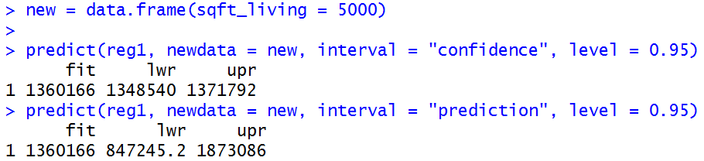
Using predict()
New data must be a data frame.
It helps to use the same column names as dataset
Same
fitted
values
95% confidence interval for average price when sqft_living = 5000
95% prediction interval for average price when sqft_living = 5000
Your “new data” may include more than one value too:

Slide 49
Interpolation
We can make inferences about any mean response within the observed range of the explanatory variable
When we don’t actually observe the value of X, it is called interpolation

Slide 50
Try to Avoid Extrapolation
Drawing conclusions about data that extends beyond the scope of the data in your sample is called extrapolation
Do NOT make inferences about data that is not within the bounds of your sample!
Same relationship may not extend to data outside observed range
May make unreliable predictions

